Slide 1

WPDD202: Webpage Design & Development
Version 2 – 18th December 2015

Slide 2
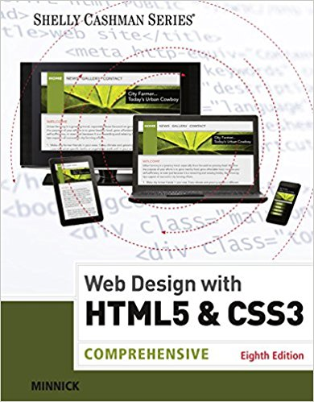
Resource Material
Web Design with HTML & CSS3: Comprehensive, 8th Edition
Jessica Minnick; Lisa Friedrichsen
ISBN-10: 1305578163 | ISBN-13: 9781305578166 © 2017
Cengage Learning Australia

Slide 3
Chapter 5
Responsive Design Part 1: Designing for Mobile Devices

Slide 4
Chapter Objectives
Explain the principles of responsive design
Describe the pros and cons of a mobile website
Explain the design principles of a mobile website
Describe a mobile-first strategy
Define a viewport
Create a fluid layout

Slide 5
Chapter Objectives (continued)
Make images flexible
Use styles for a mobile viewport
Insert and style a span element
Insert a viewport meta tag
Test a responsive site using a device emulator

Slide 6
Exploring Responsive Design
Responsive design
Responsive design is a website development strategy that strives to provide an optimal user experience of a website regardless of the device or browser used
The content in responsive design is easy to read and navigate on devices of three sizes: desktop browser, tablet, and phone

Slide 7
Exploring Responsive Design (continued 1)
The three concepts of responsive design are:
Fluid layout:
Applies proportional size measurements to the webpage wireframe and content
The viewport is the viewing area for the webpage

Slide 8
Exploring Responsive Design (continued 2)
Media queries
Allow the webpage developer to detect the approximate pixel size of the current viewport
Allow the developer to selectively apply CSS rules that work best for that viewport size

Slide 9
Exploring Responsive Design (continued 3)
Flexible images
They shrink and grow based on the size of the viewport
They do not have height and width attributes or values in the HTML document
They use CSS rules to resize the image relative to the wireframe and viewport

Slide 10
Designing for Mobile Devices
Mobile websites
Techniques emerged to build a completely separate, parallel website optimized for mobile users called a mobile website to address problems with viewports
They are identified with an m. or mo. prefix in the URL
In contrast, responsive design optimizes the viewing experience for a wide range of devices using one website

Slide 11
Designing for Mobile Devices (continued 1)
Mobile-first strategy
Employs responsive design principles
In this, a web developer designs the flexible wireframe and essential content for the smallest viewport first, progressively adding more content as the viewport grows
Then, media queries are used to add styles for progressively larger viewports, progressing from tablet to laptop and desktop
It is a more productive and effective way to build a website from scratch

Slide 12
Designing for Mobile Devices (continued 2)
Implementation of the website development approach depends on many factors, such as:
the current environment
the target audience
available resources
the time available to tackle the project

Slide 13
Using Fluid Layouts
Fluid layout
It is also known as a webpage with a liquid layout
It changes in width based on the size of the viewport
Responsive designs are based on fluid layouts

Slide 14
Using Fluid Layouts (continued 1)
Fixed layouts
They do not change in width based on the size of the viewport
They use fixed measurement units such as pixels to define the width of the areas of the wireframe that “fix” the width of the content regardless of the size of the viewport
It is implemented by measuring the widths of the wireframe elements and content in relative units such as percentages and ems

Slide 15
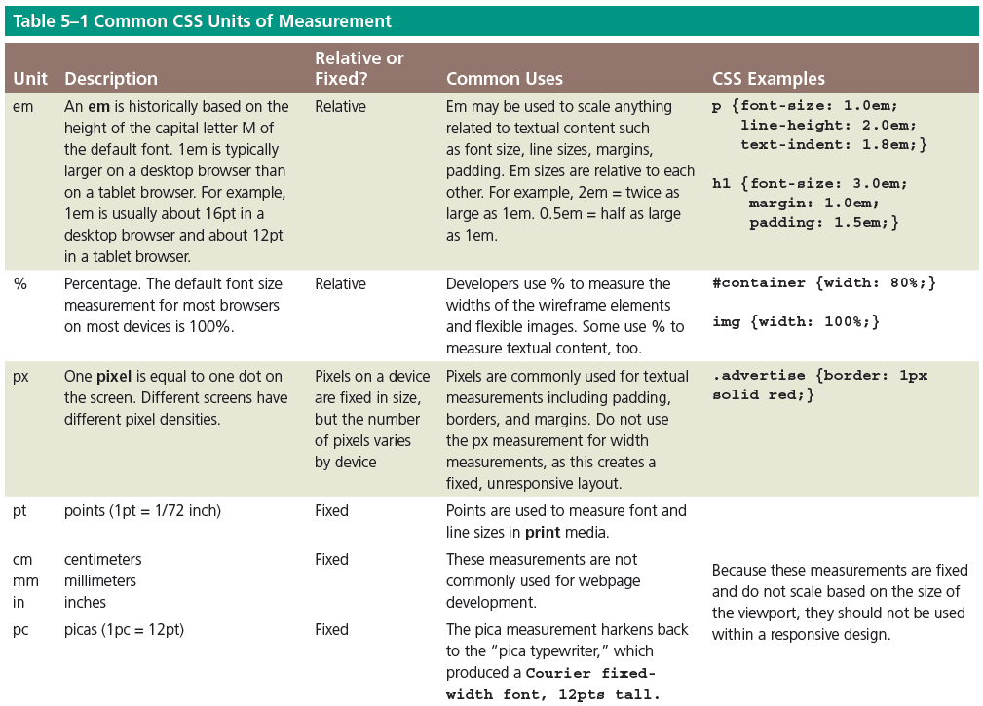
Using Fluid Layouts (continued 2)

Slide 16
Creating a Fluid Layout
It is created by using percentages to measure the width of each column in a webpage
A webpage can have a liquid layout without using media queries
No matter how small a browser becomes, the content placeholder boxes on the page shrink and grow in response to the size of the viewport

Slide 17
Creating a Fluid Layout (continued 1)
To make the navigation links more appealing on a webpage, they can be formatted so they look like buttons rather than text links

Slide 18
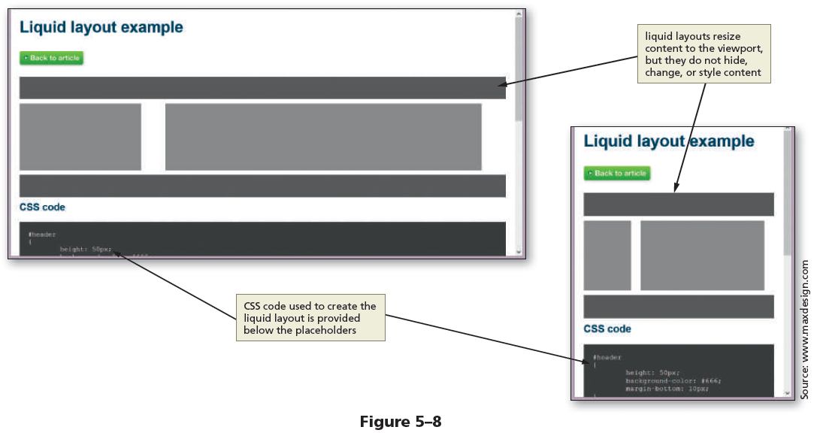
Creating a Fluid Layout (continued 2)
Figure 5–8 shows a webpage with a liquid layout in two widths

Slide 19
Making Images Flexible
Flexible image – It resizes itself to accommodate the size of the viewport and is easy to implement
Creating flexible images:
1. Delete the height and width attribute values for the img tags in the HTML files
2. Add styles for the images in the CSS file to provide the desired flexibility such as the following style: max-width: 100%;

Slide 20
Making Images Flexible (continued)
By setting the width of the image to 100%, the image automatically stretches to fill 100% of the width of the container element

Slide 21
Following a Mobile-First Strategy
It is better to use a single-column layout for a mobile display as this prevents scrolling horizontally
Styling content for mobile devices requires that each page be analyzed to determine the most important content on the page, and then style that content to attract users of mobile devices

Slide 22
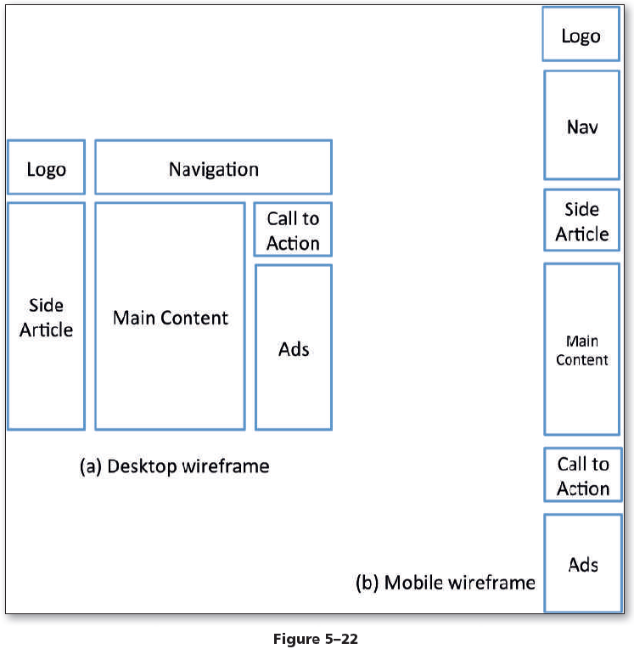
Following a Mobile-First Strategy (continued 1)
Figure 5–22a depicts a wireframe example for a traditional desktop viewport, while Figure 5–22b depicts all these same areas of content for a mobile design

Slide 23
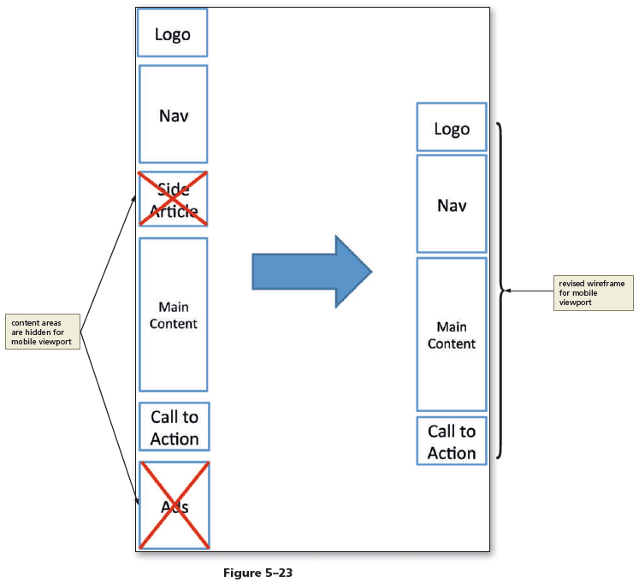
Following a Mobile-First Strategy (continued 2)
Figure 5–23 shows how to hide some webpage areas to create a revised mobile wireframe

Slide 24
Following a Mobile-First Strategy (continued 3)
Optimize the interface to maximize the mobile user experience
Some of the key best practices when designing for mobile viewports are as follows:
1. Make use of 100% of the screen space
2. Design the navigation to be easy and intuitive
3. Keep load times minimal. Enhance load times by removing bandwidth-intensive content and streamlining your HTML code

Slide 25
Following a Mobile-First Strategy (continued 4)
4. Display essential page content and hide nonessential page content
5. Make the content easy to access and read
6. Design a simple layout

Slide 26
Using the Span Element
span element
Allows the use of CSS to format a span of text separately from its surrounding text
The <span> and </span> are the start and the end tags
As an inline element, it can be applied to text within a block
A class can be added to a span element to style its text

Slide 27
Using the Span Element (continued)
For example, the following code shows a phone number wrapped in span element.
<span class="desktop">(814) 555-9608</span>

Slide 28
Adding Meta Tags
For responsive sites, add the following meta tag to the head section of each webpage.
<meta name="viewport" content="width=device-width, initial-scale=1">
This code makes sure that the page initially loads in a layout width that matches the viewport of the device

Slide 29
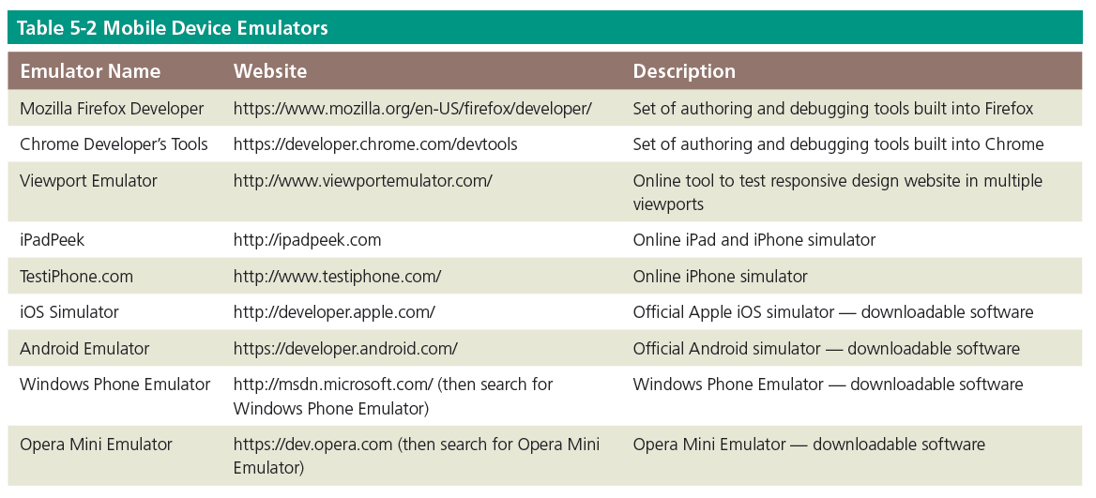
Testing Webpages in Viewports of Different Sizes

Slide 30

kent.edu.au Kent Institute Australia Pty. Ltd. ABN 49 003 577 302 ● CRICOS Code: 00161E ● RTO Code: 90458 ● TEQSA Provider Number: PRV12051

